Slide 1
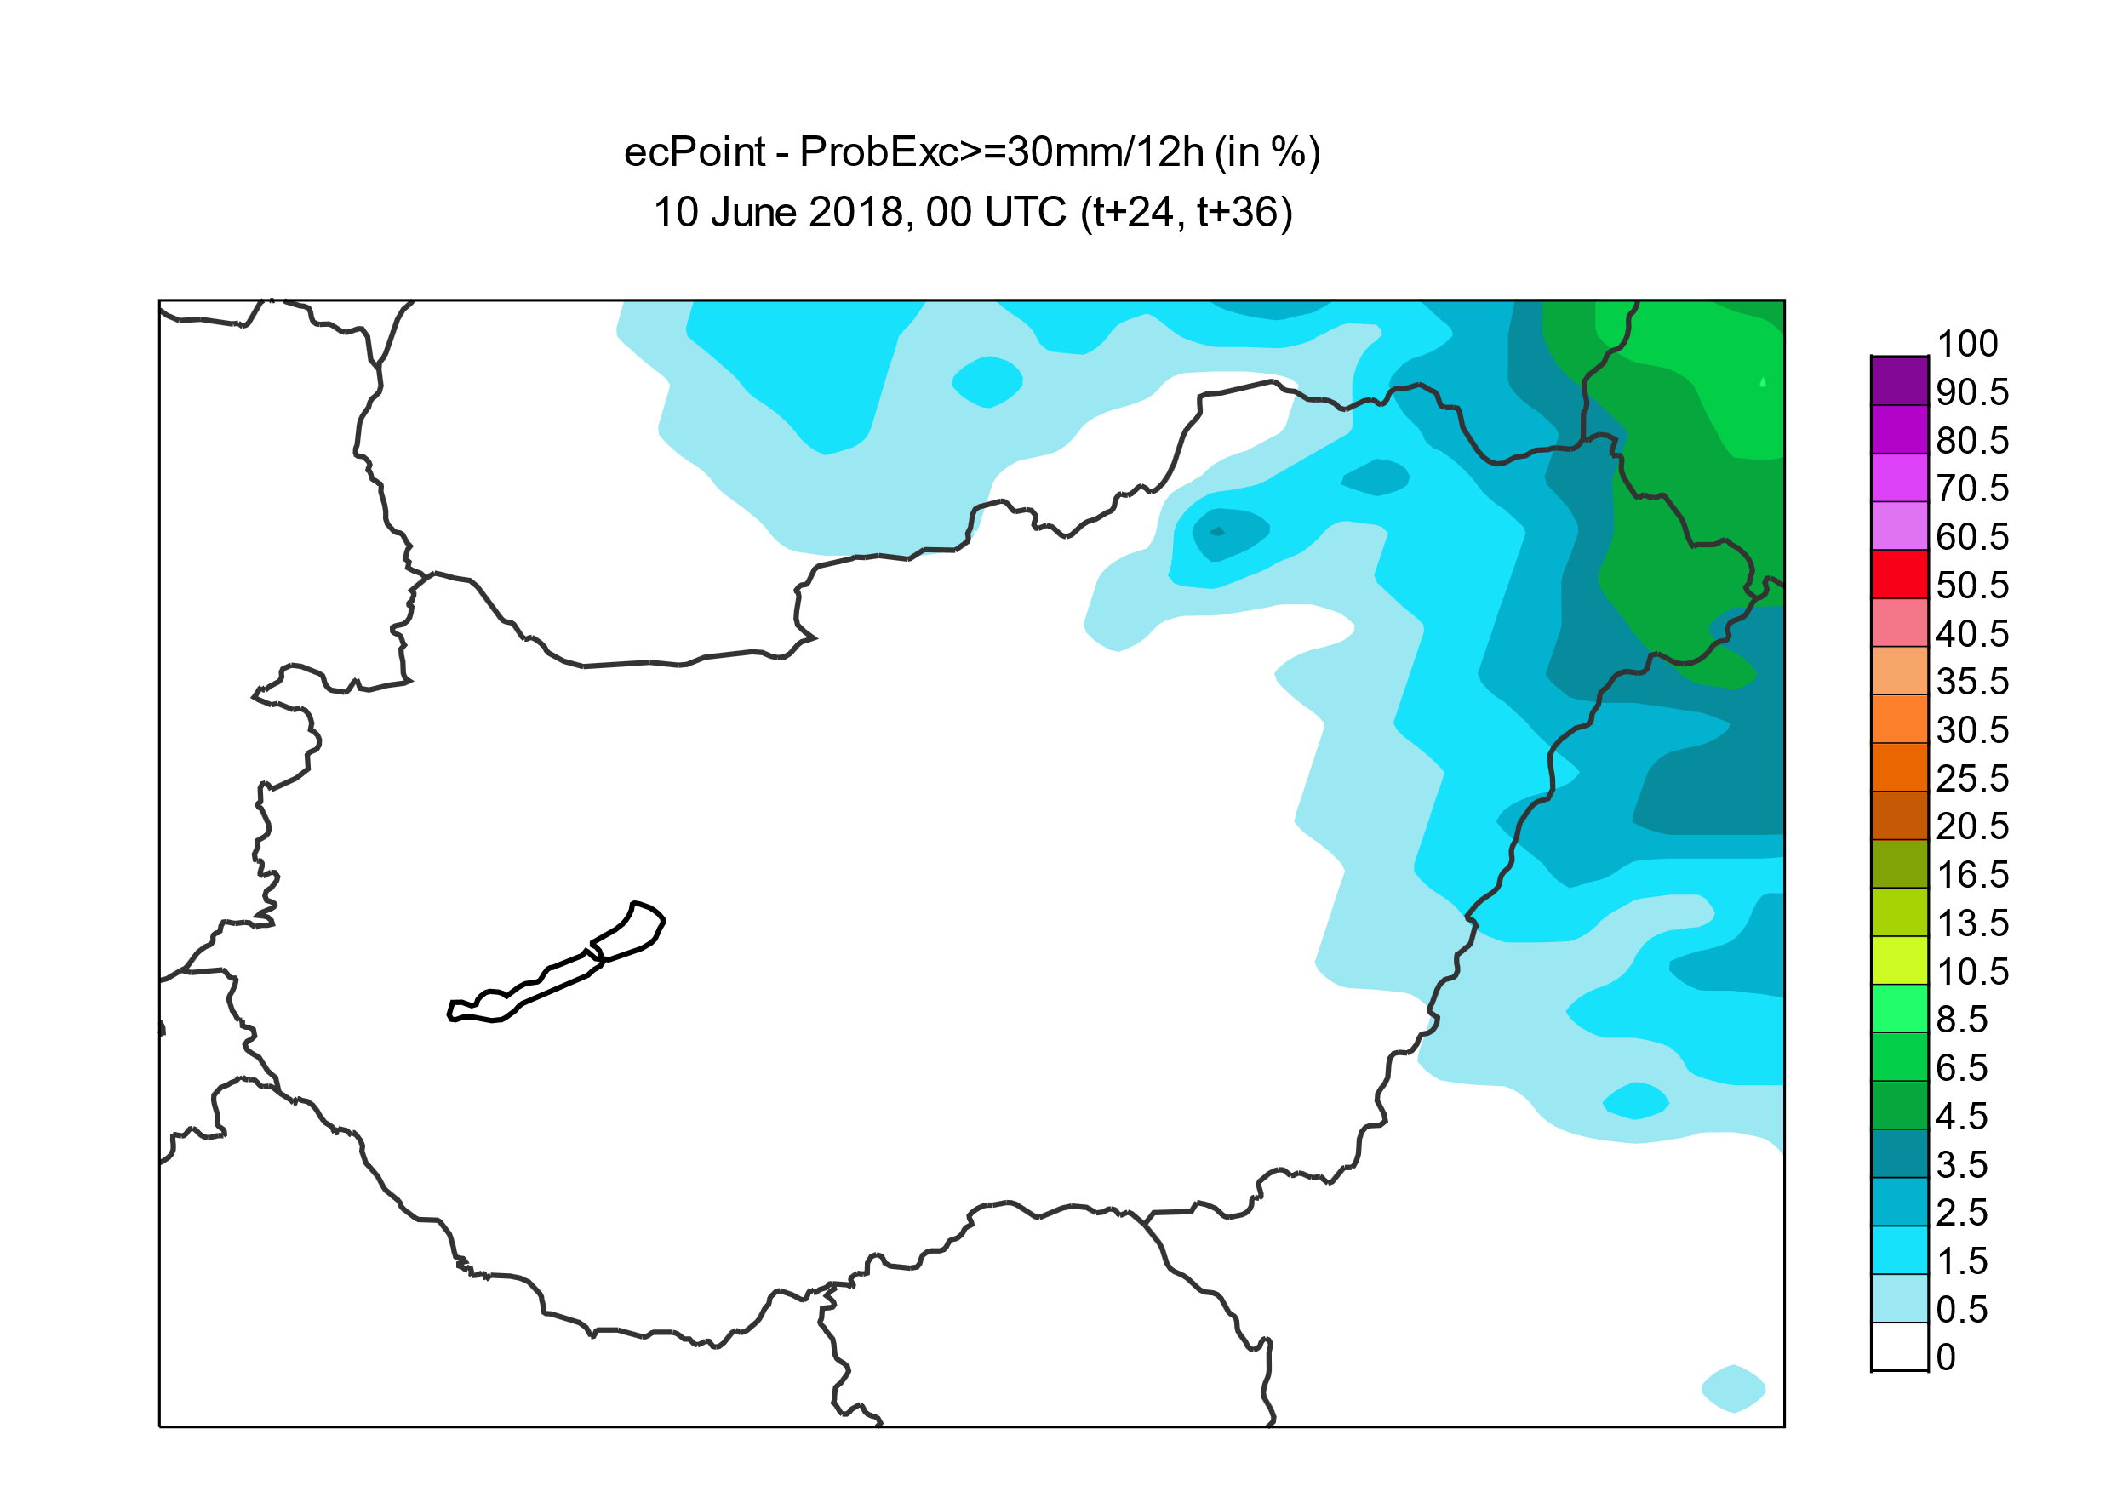
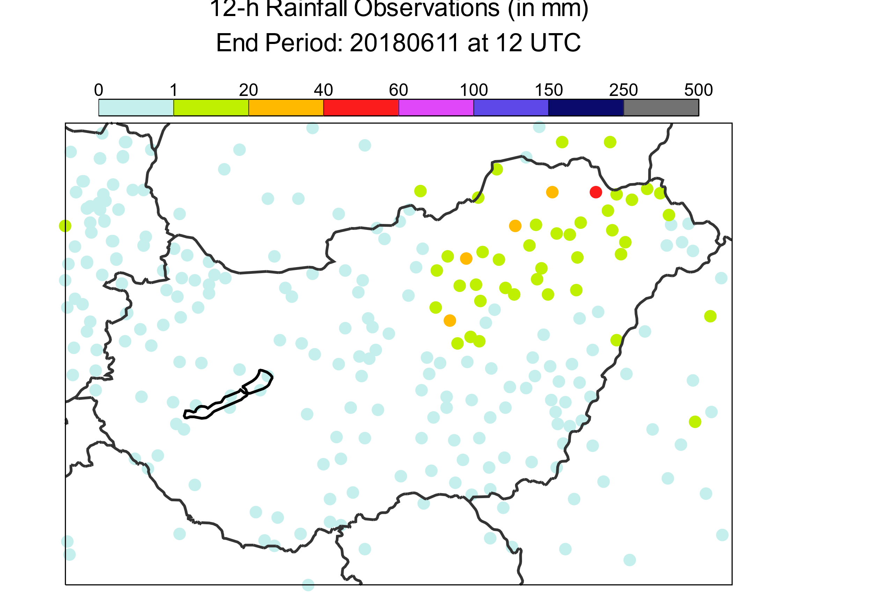
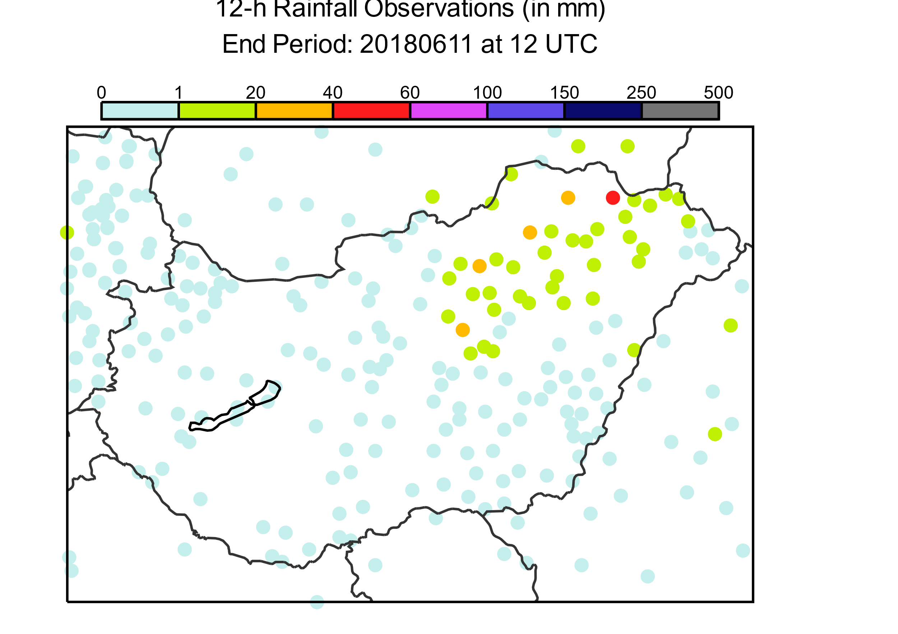
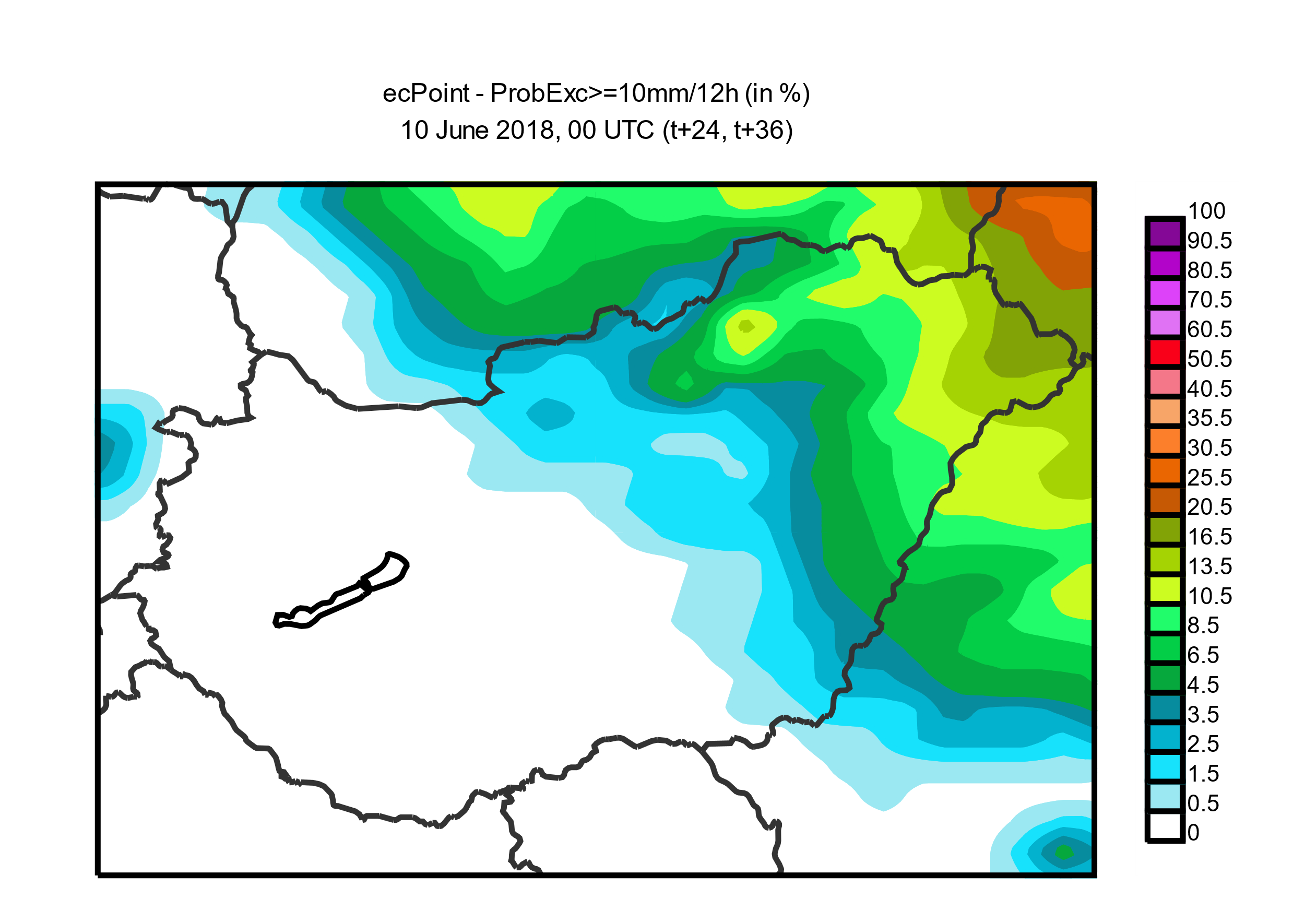
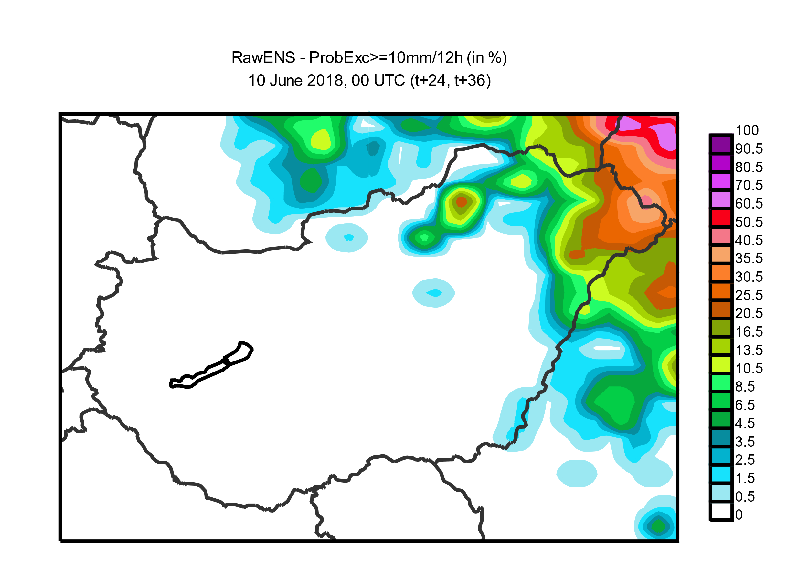
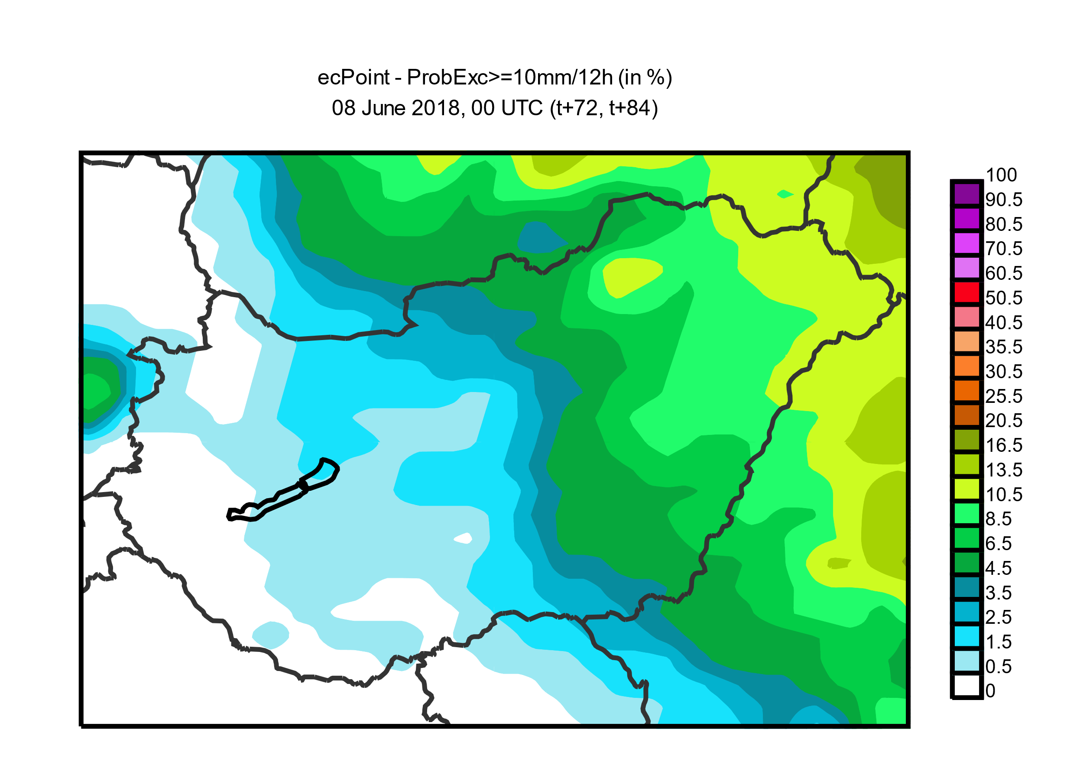
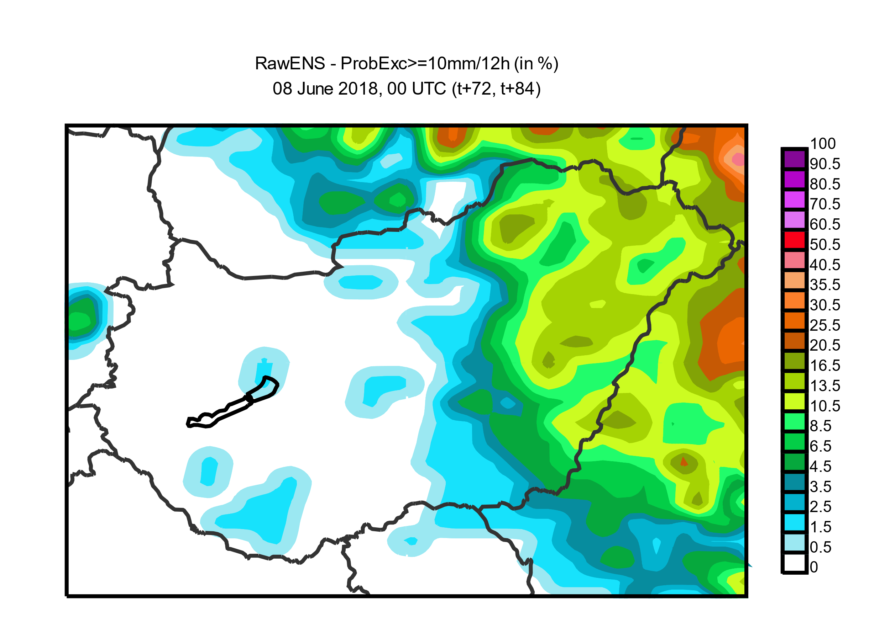
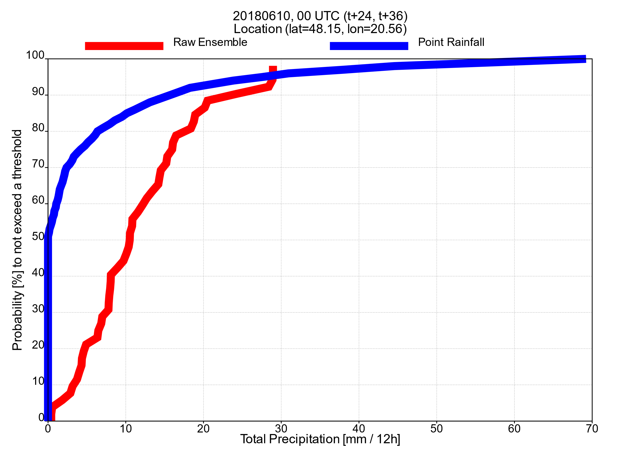
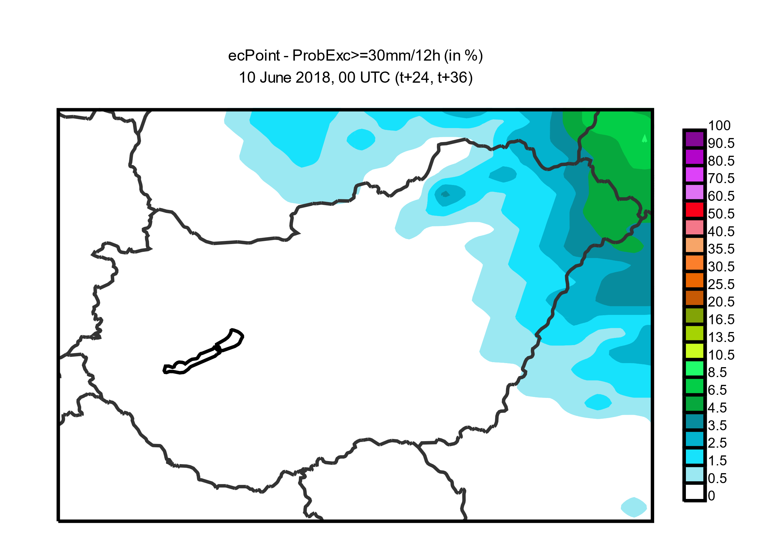
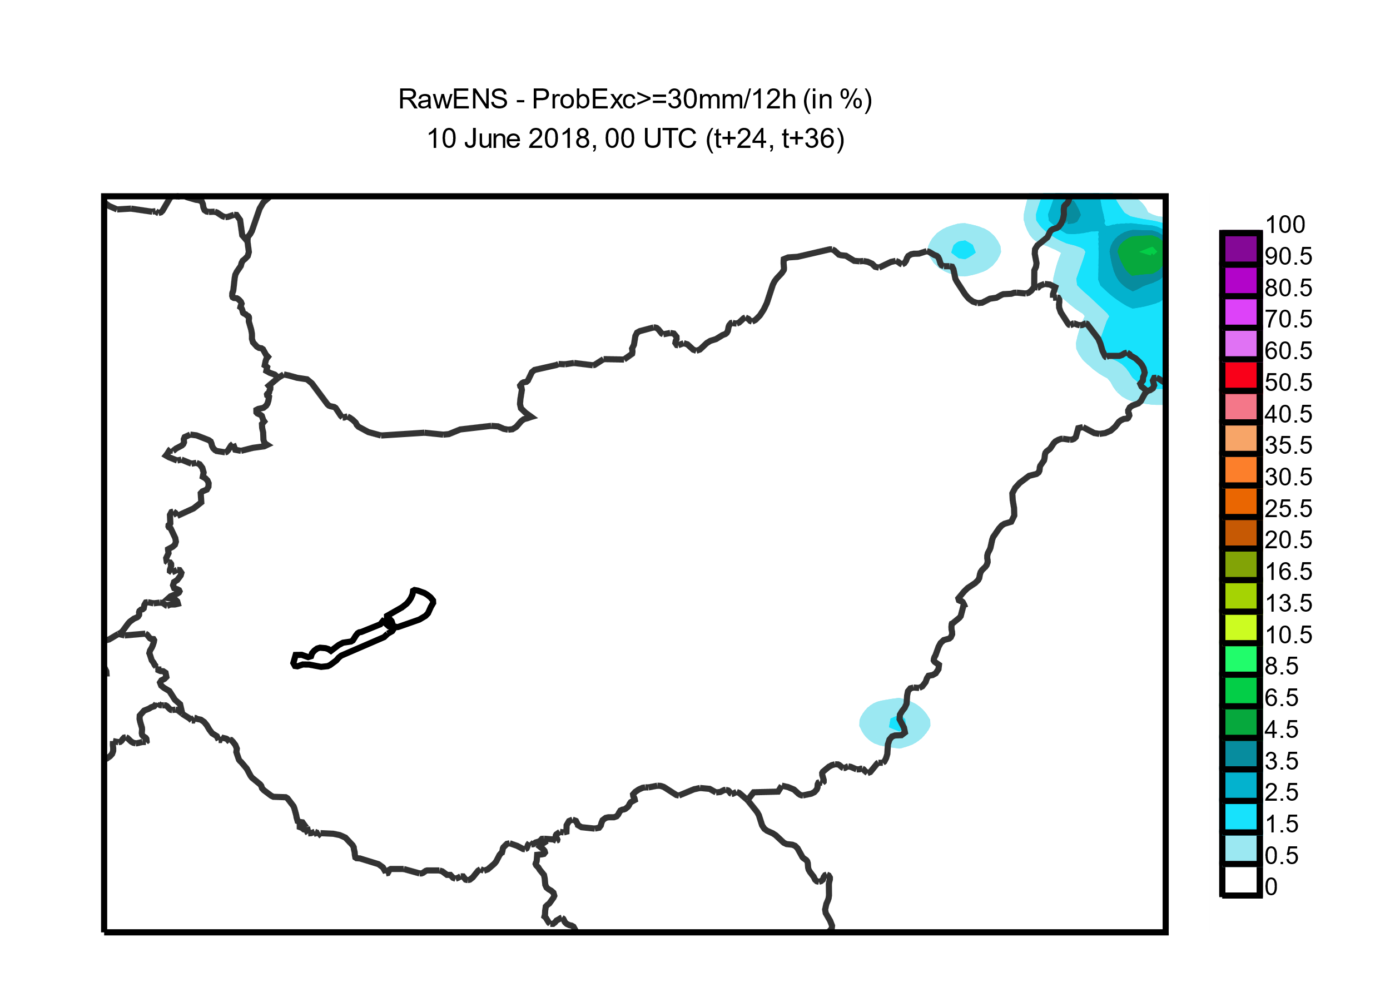
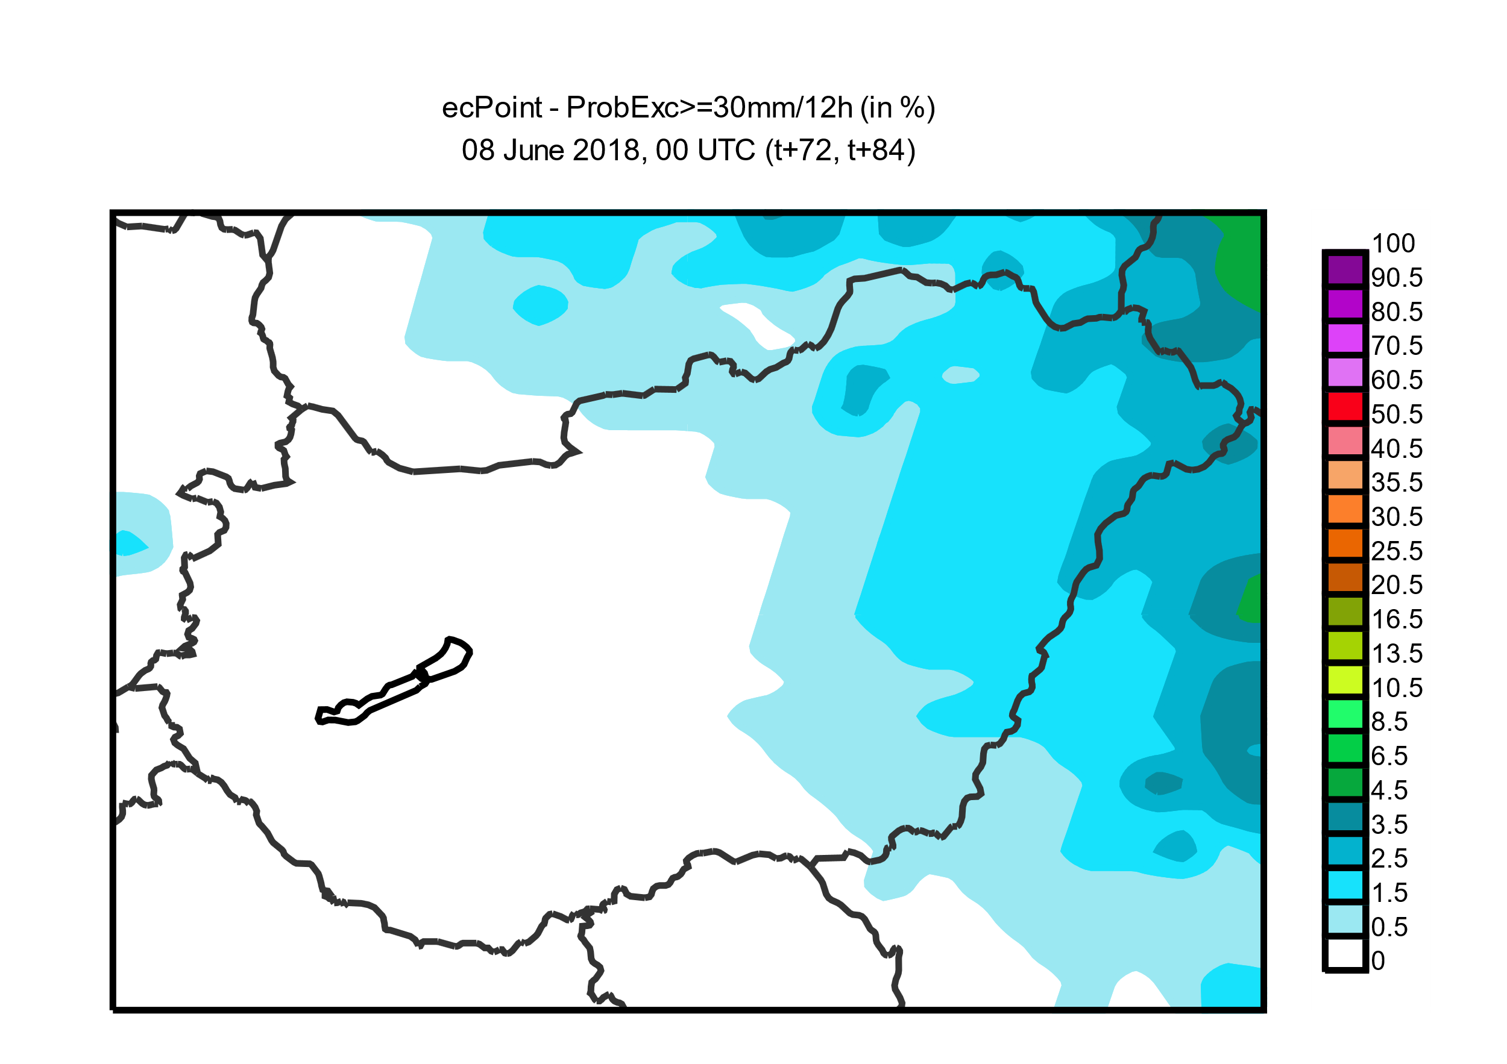
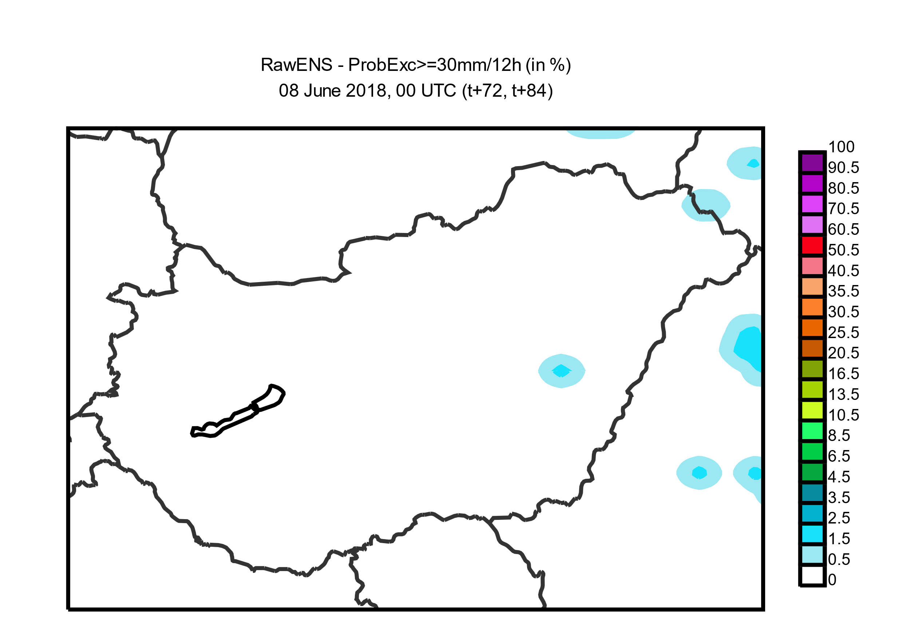
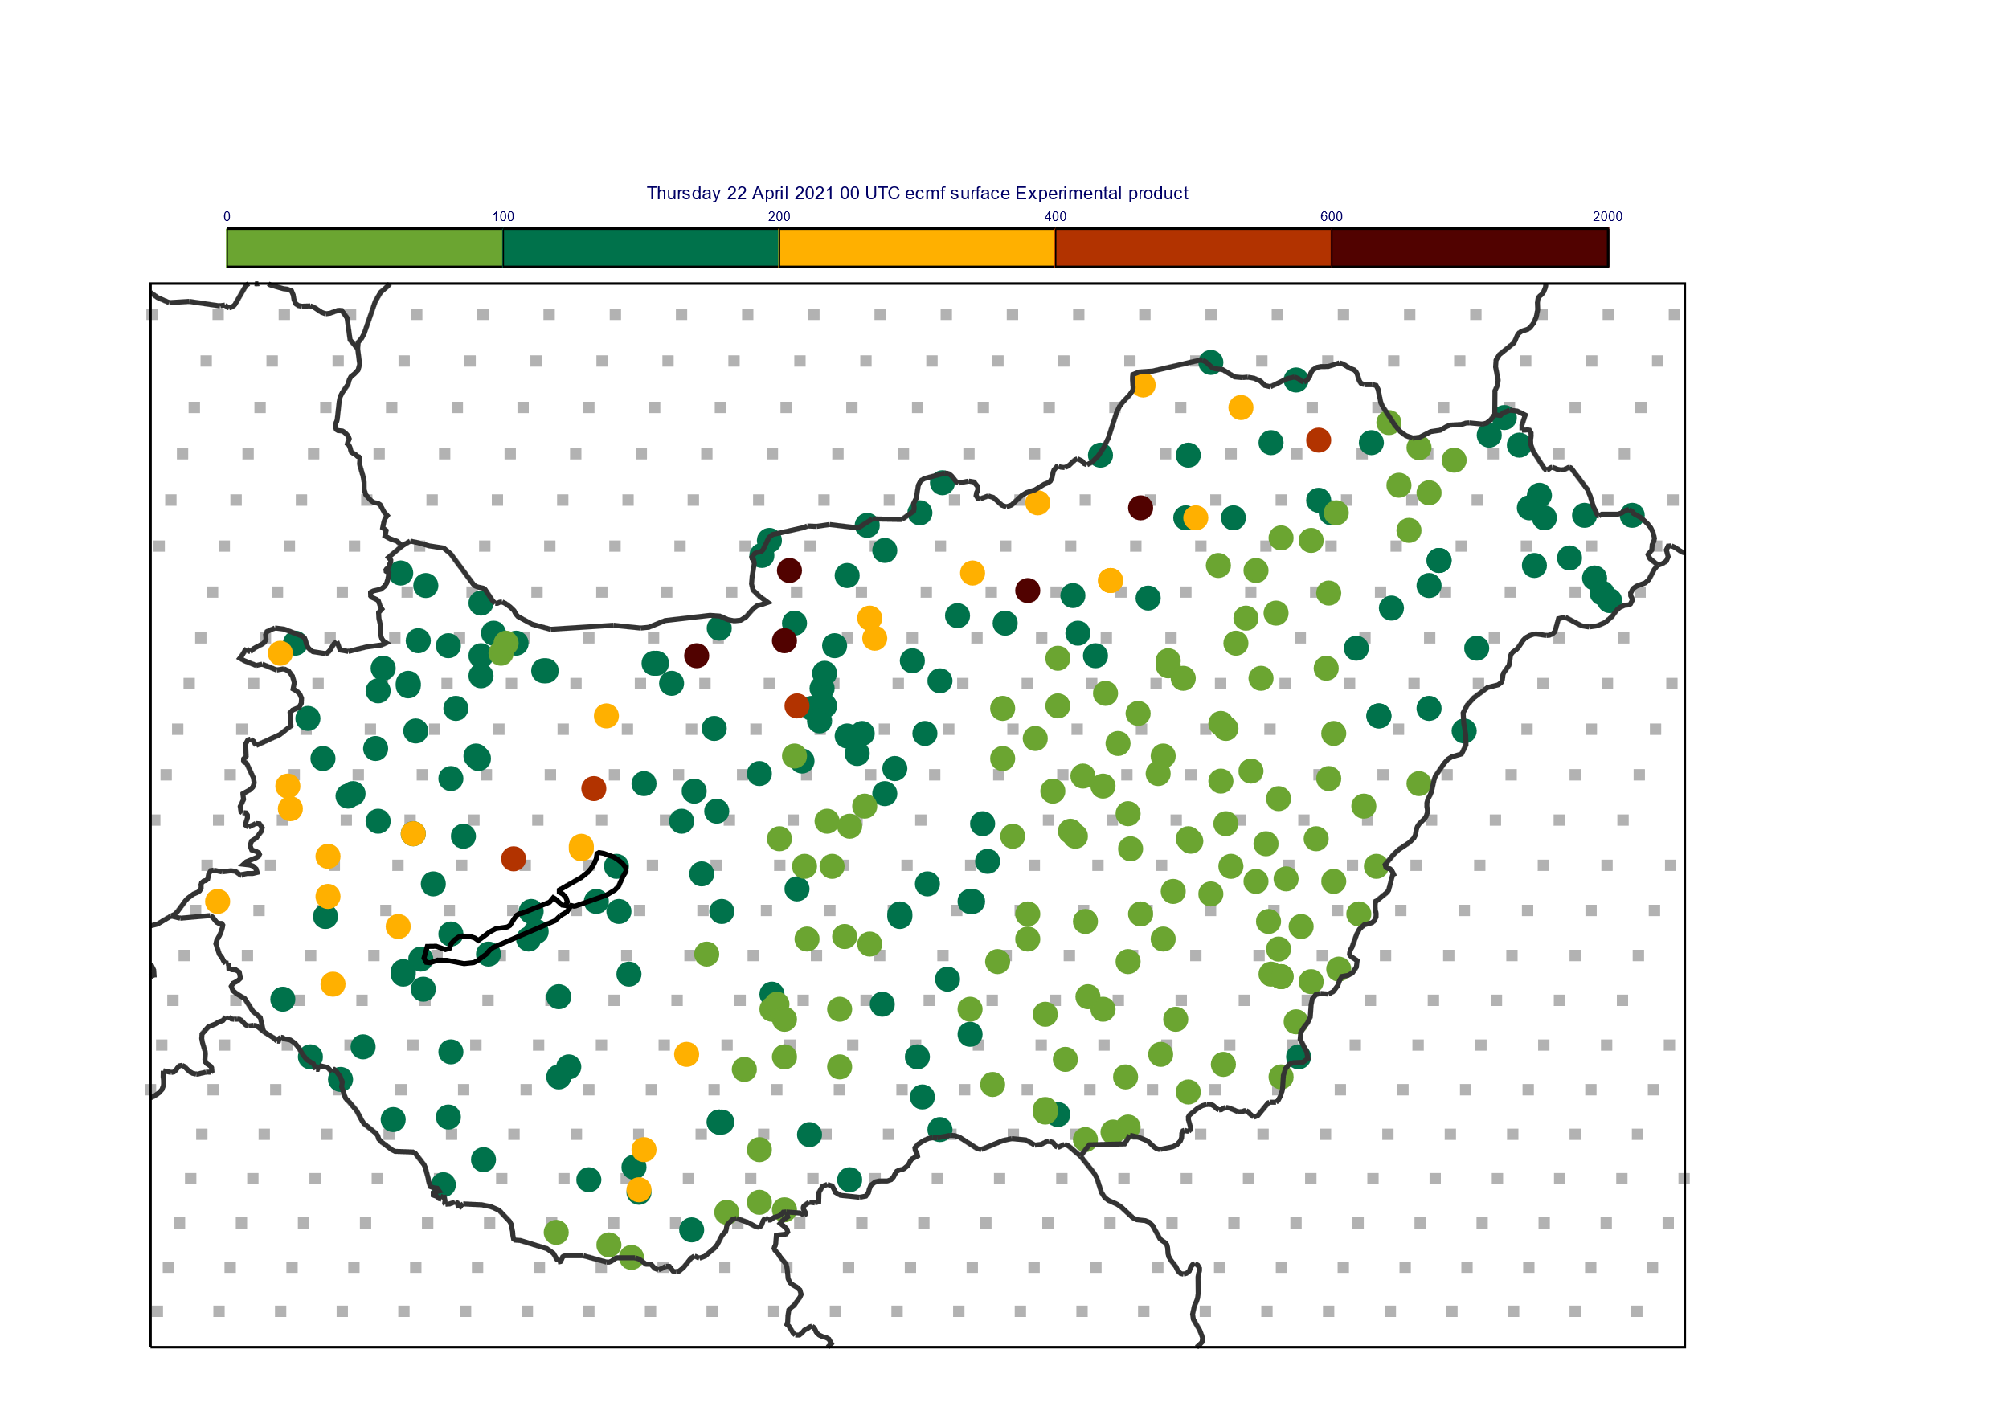
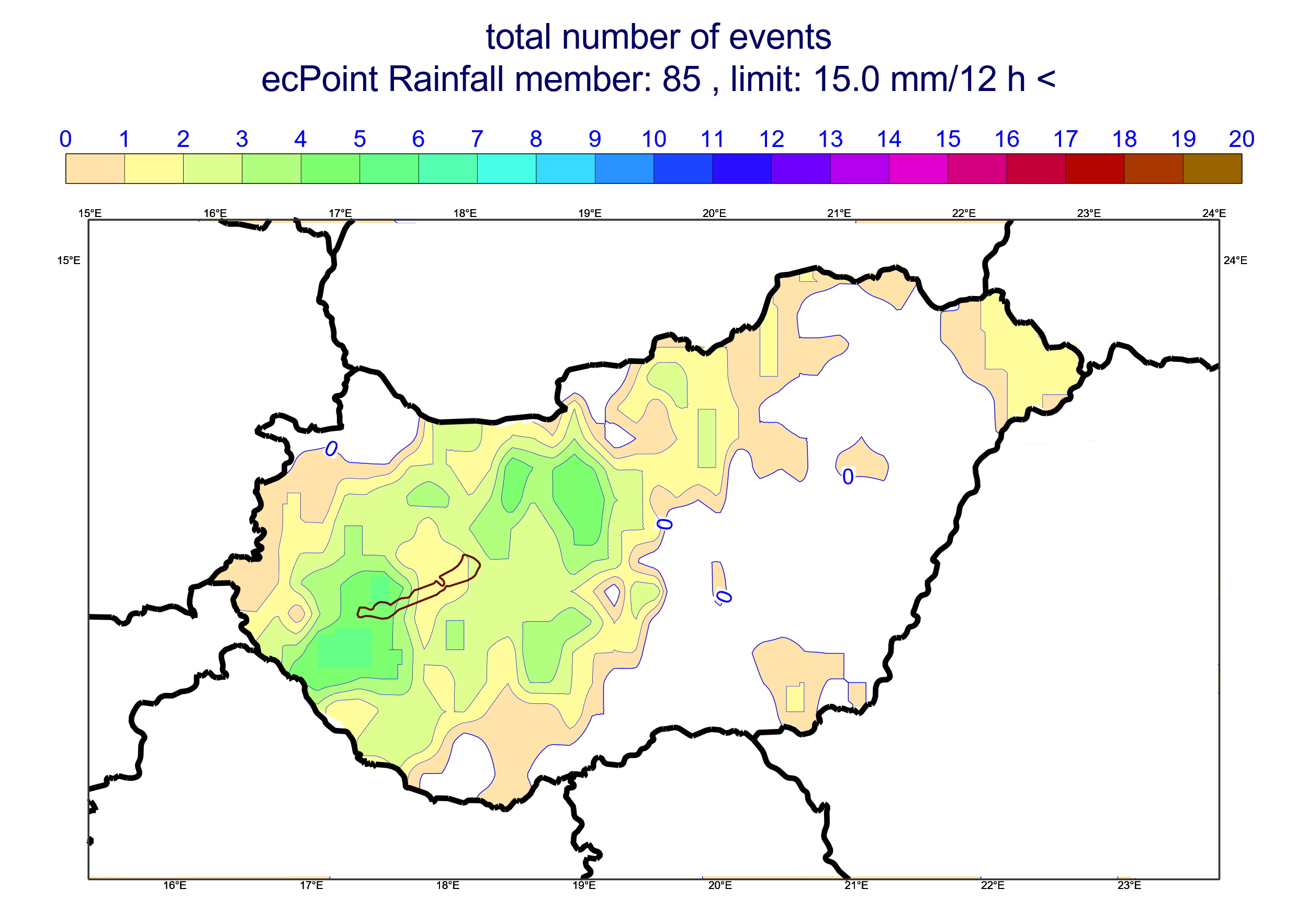
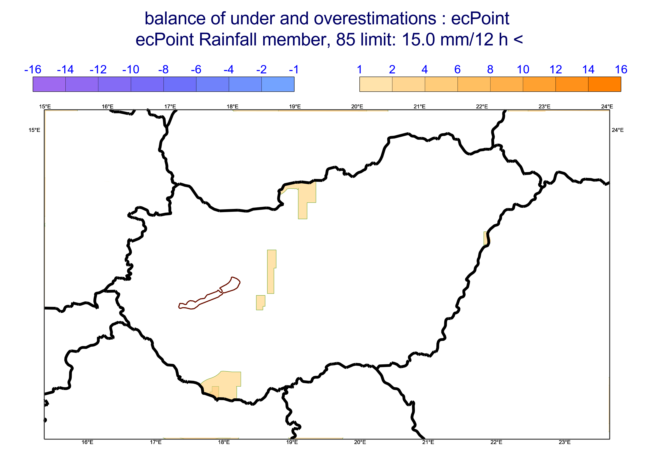
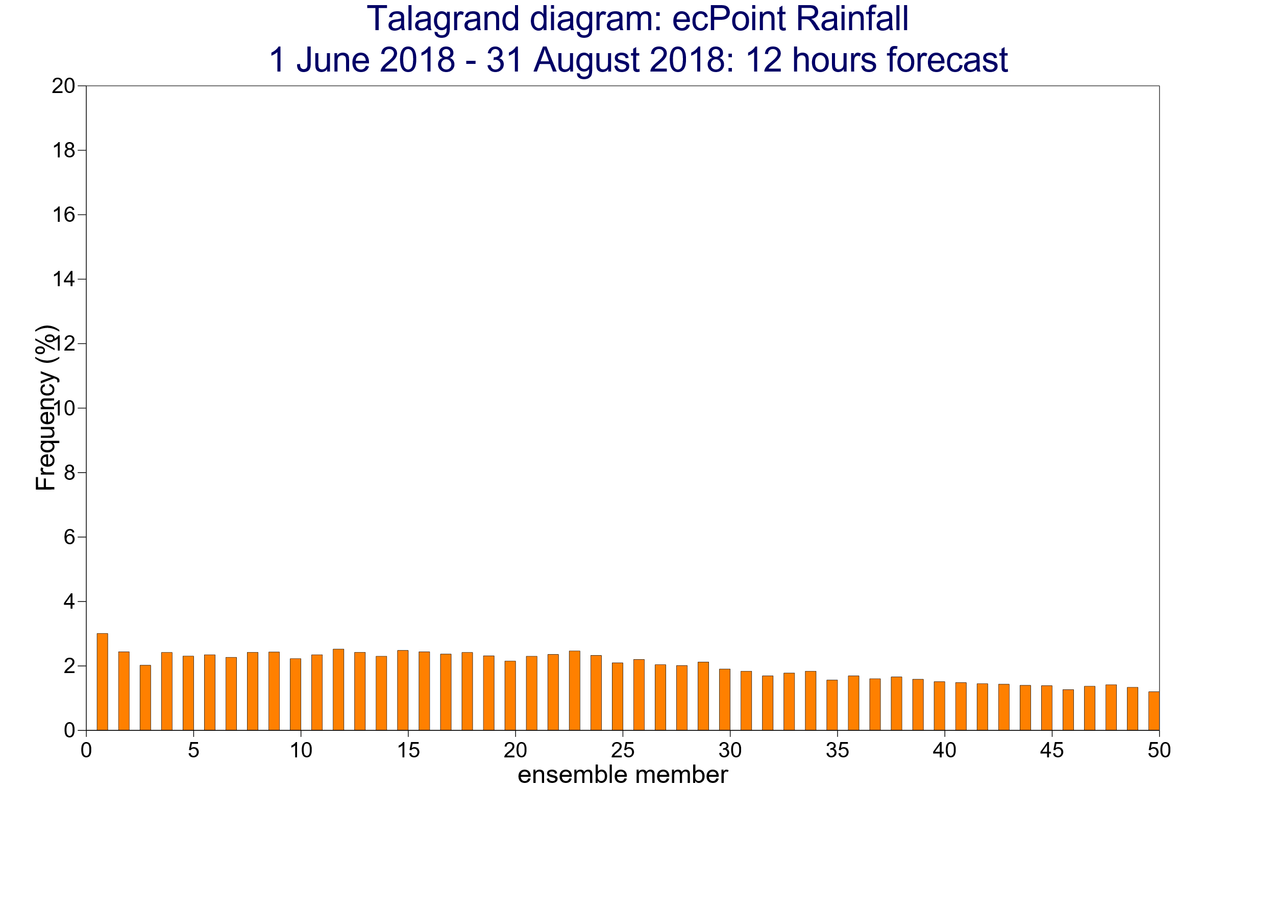
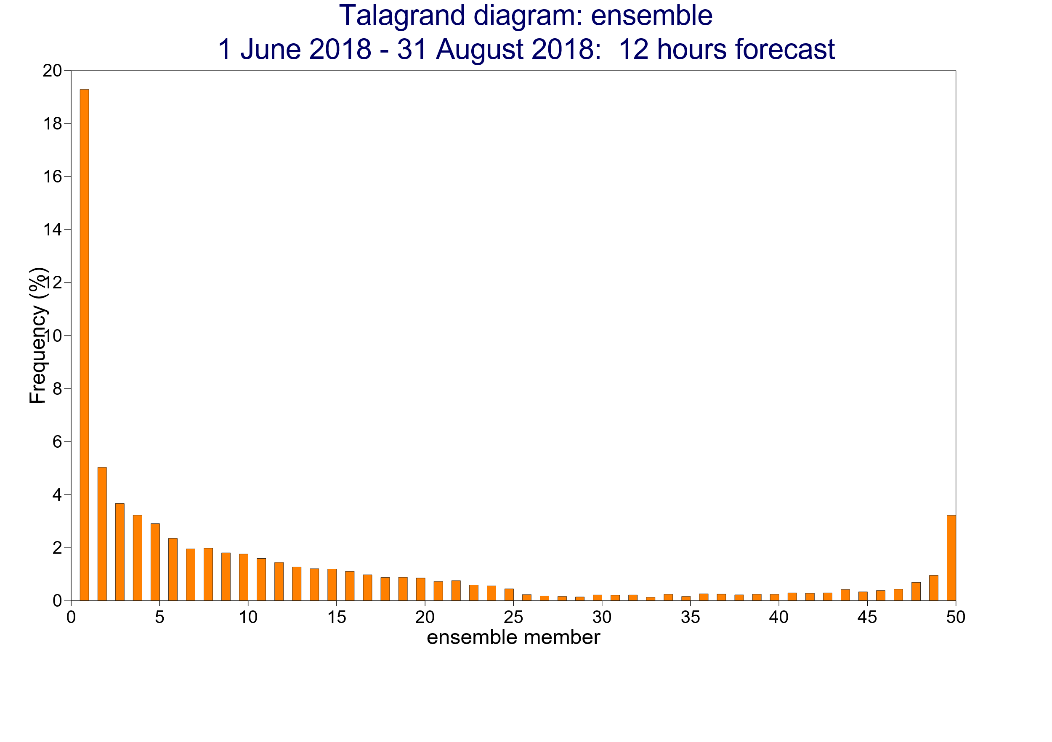
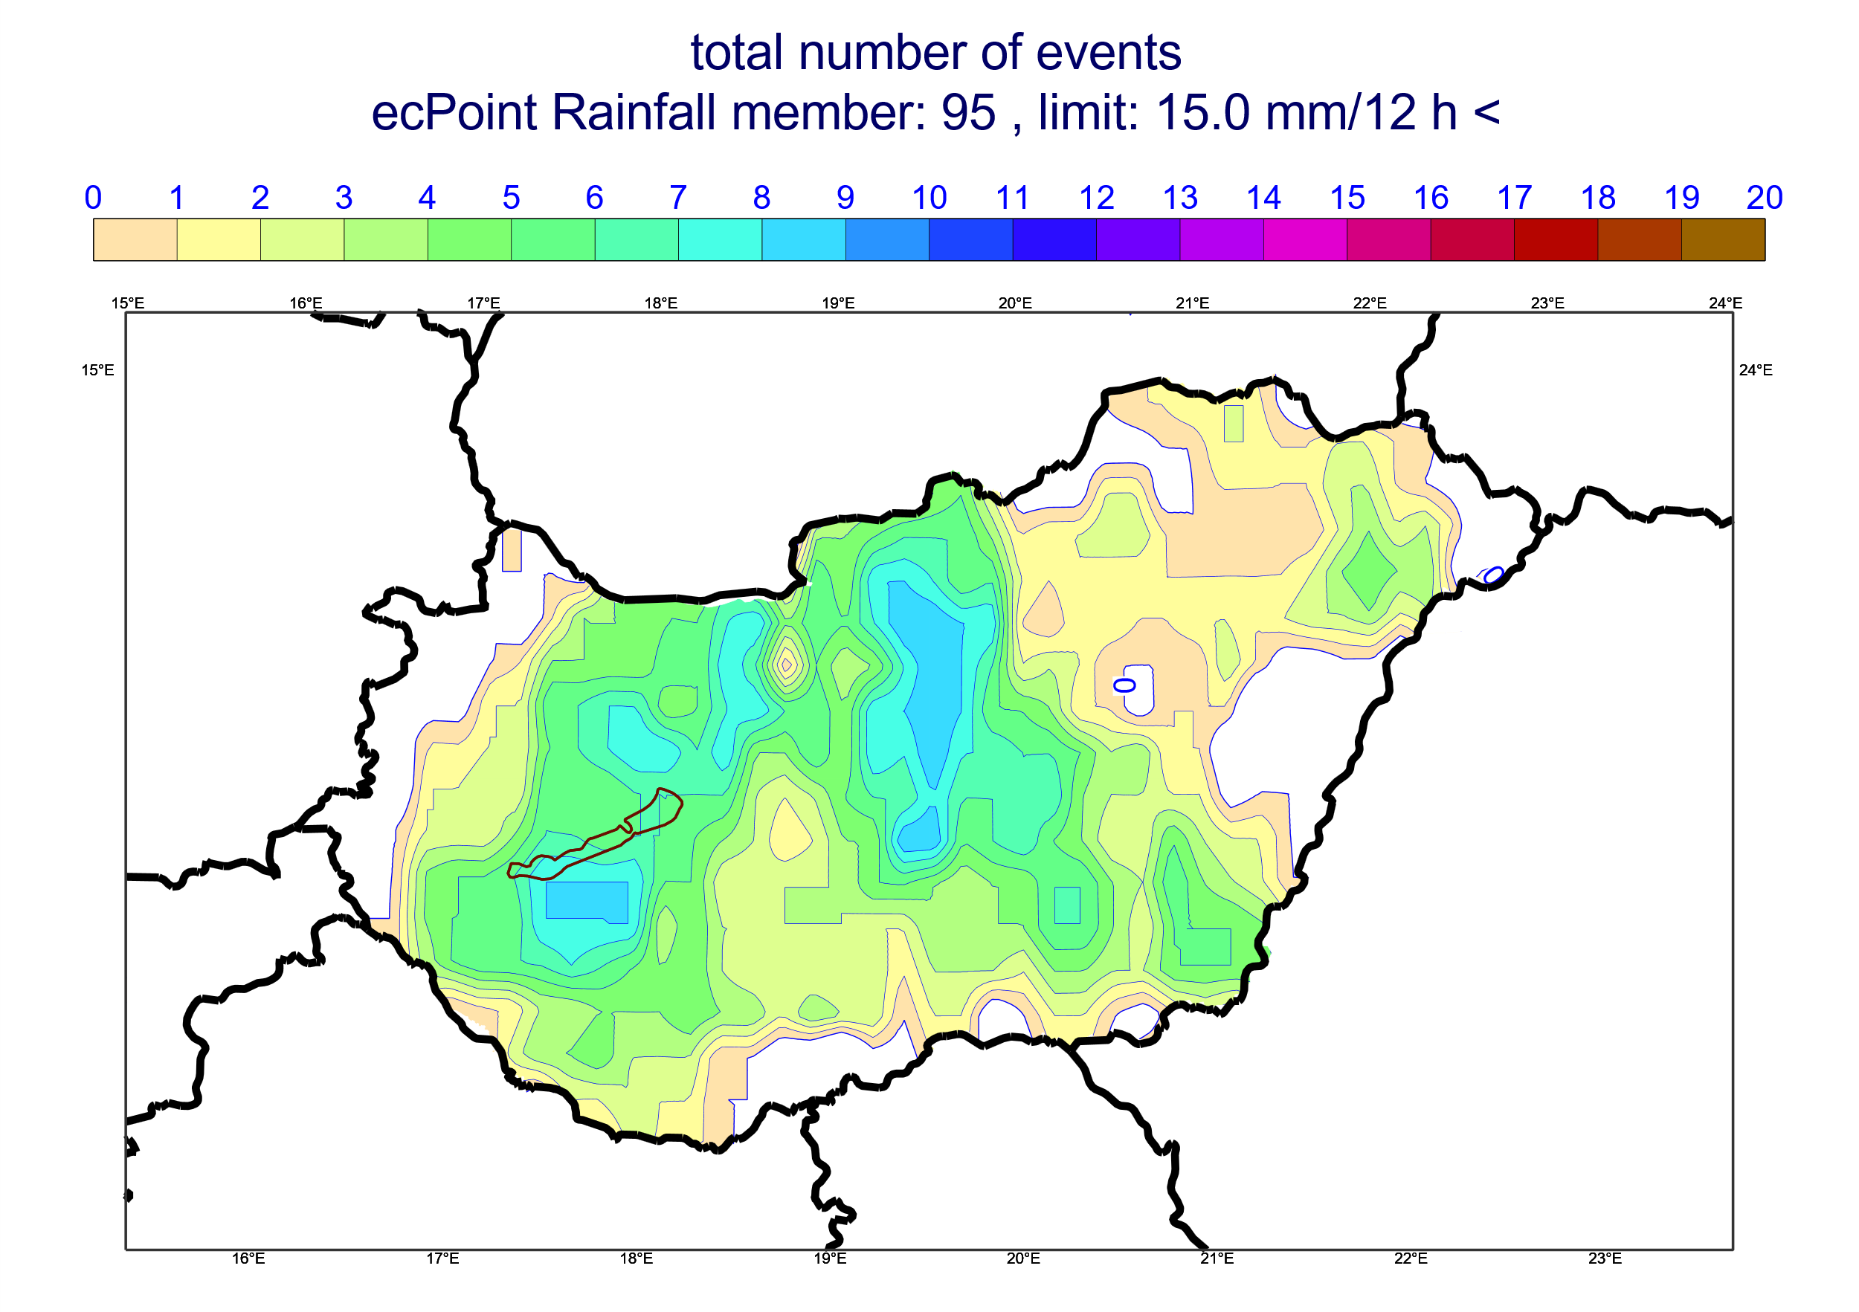
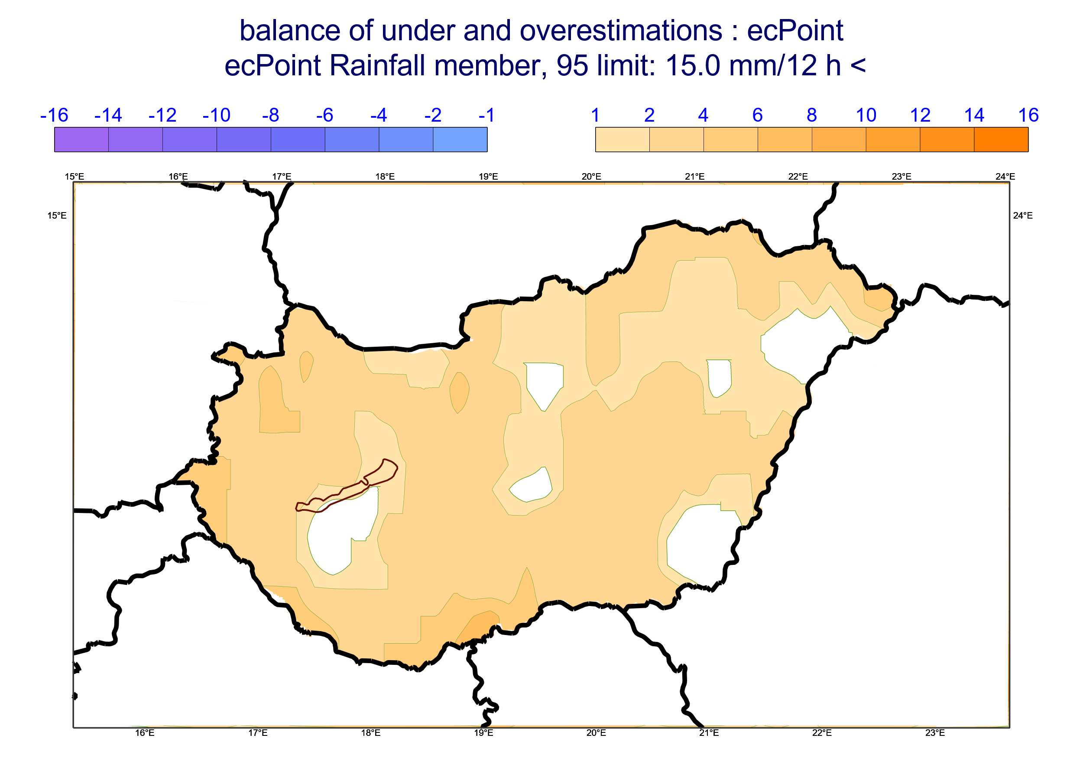
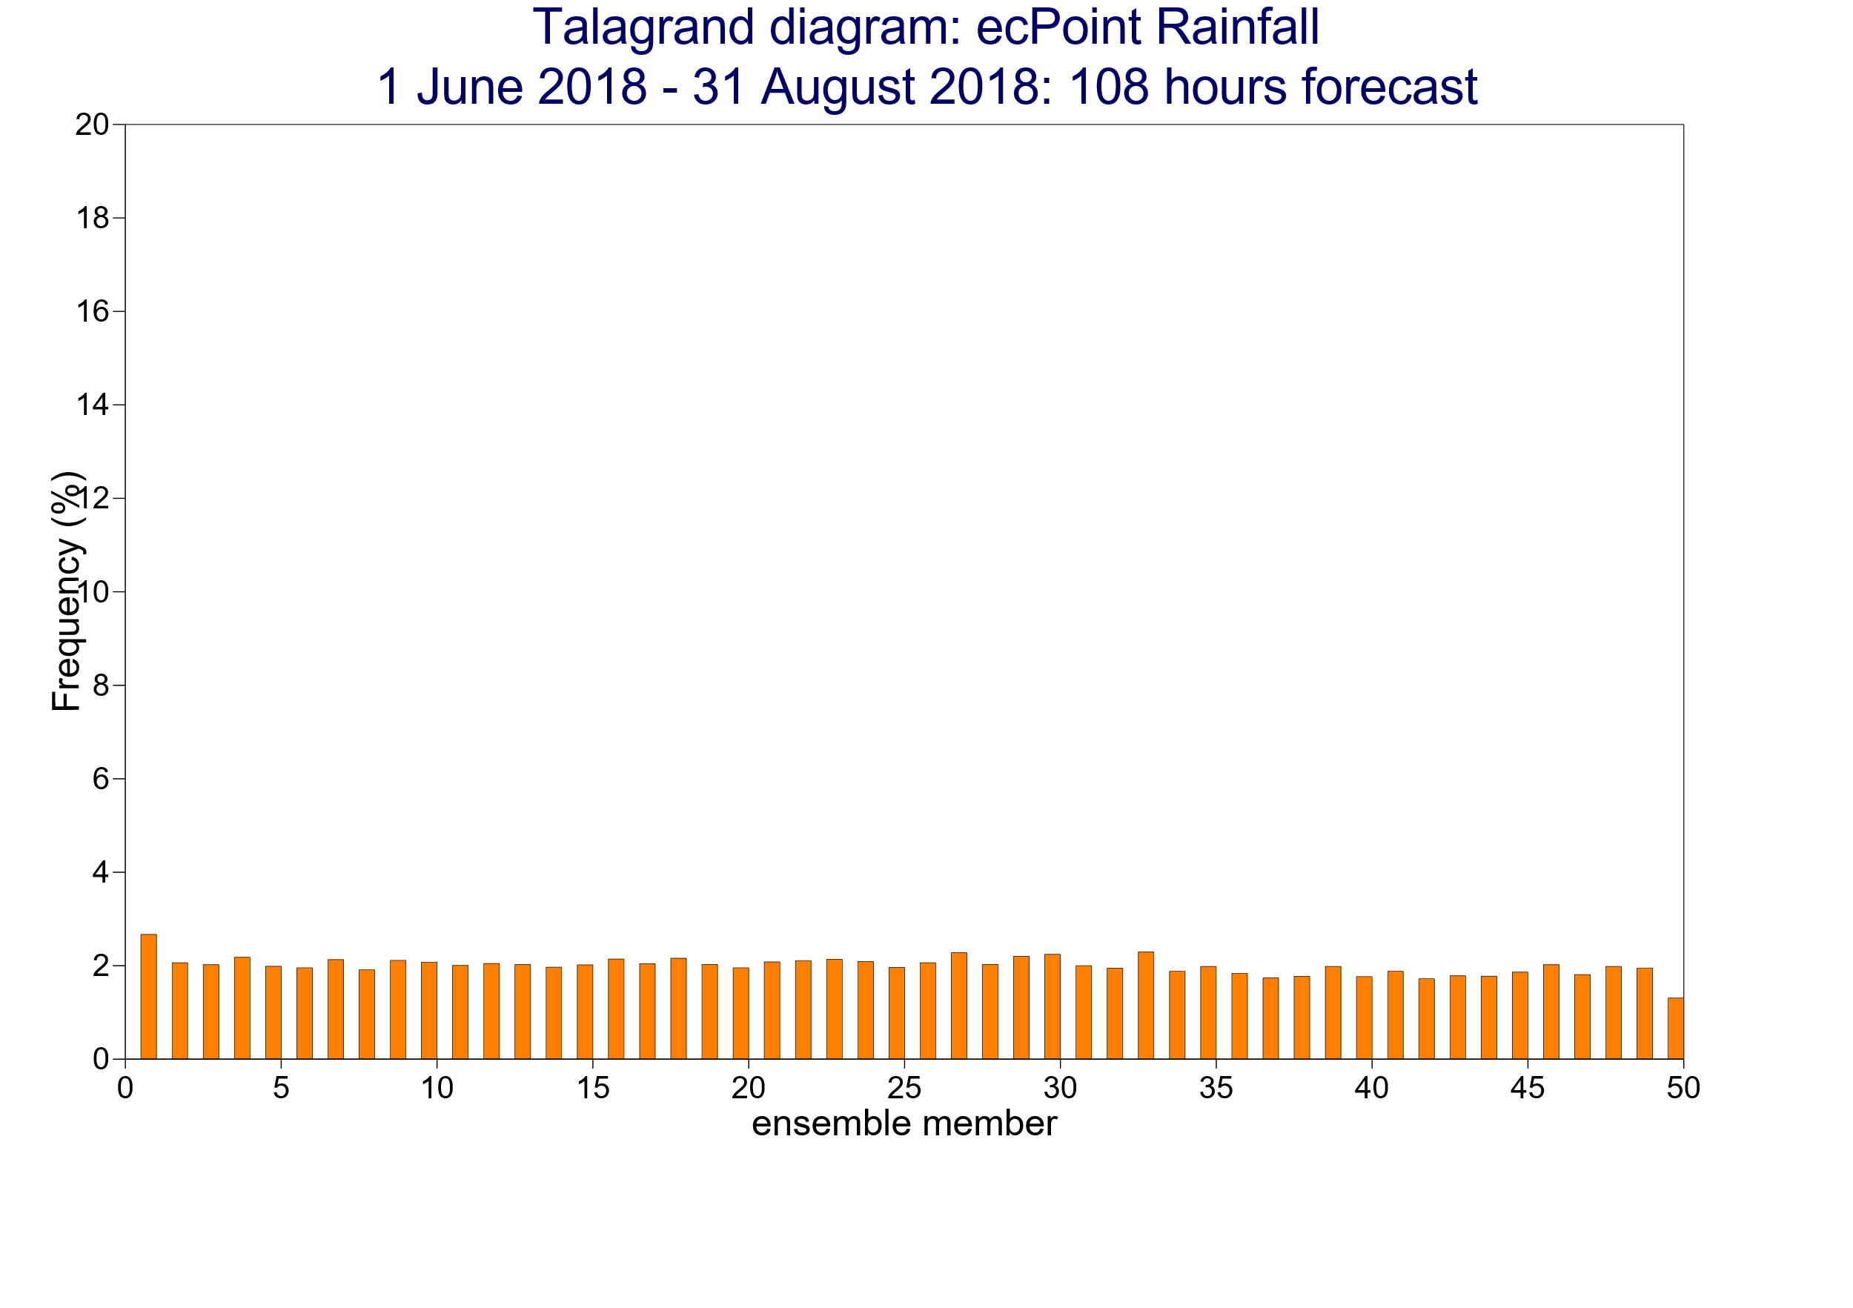
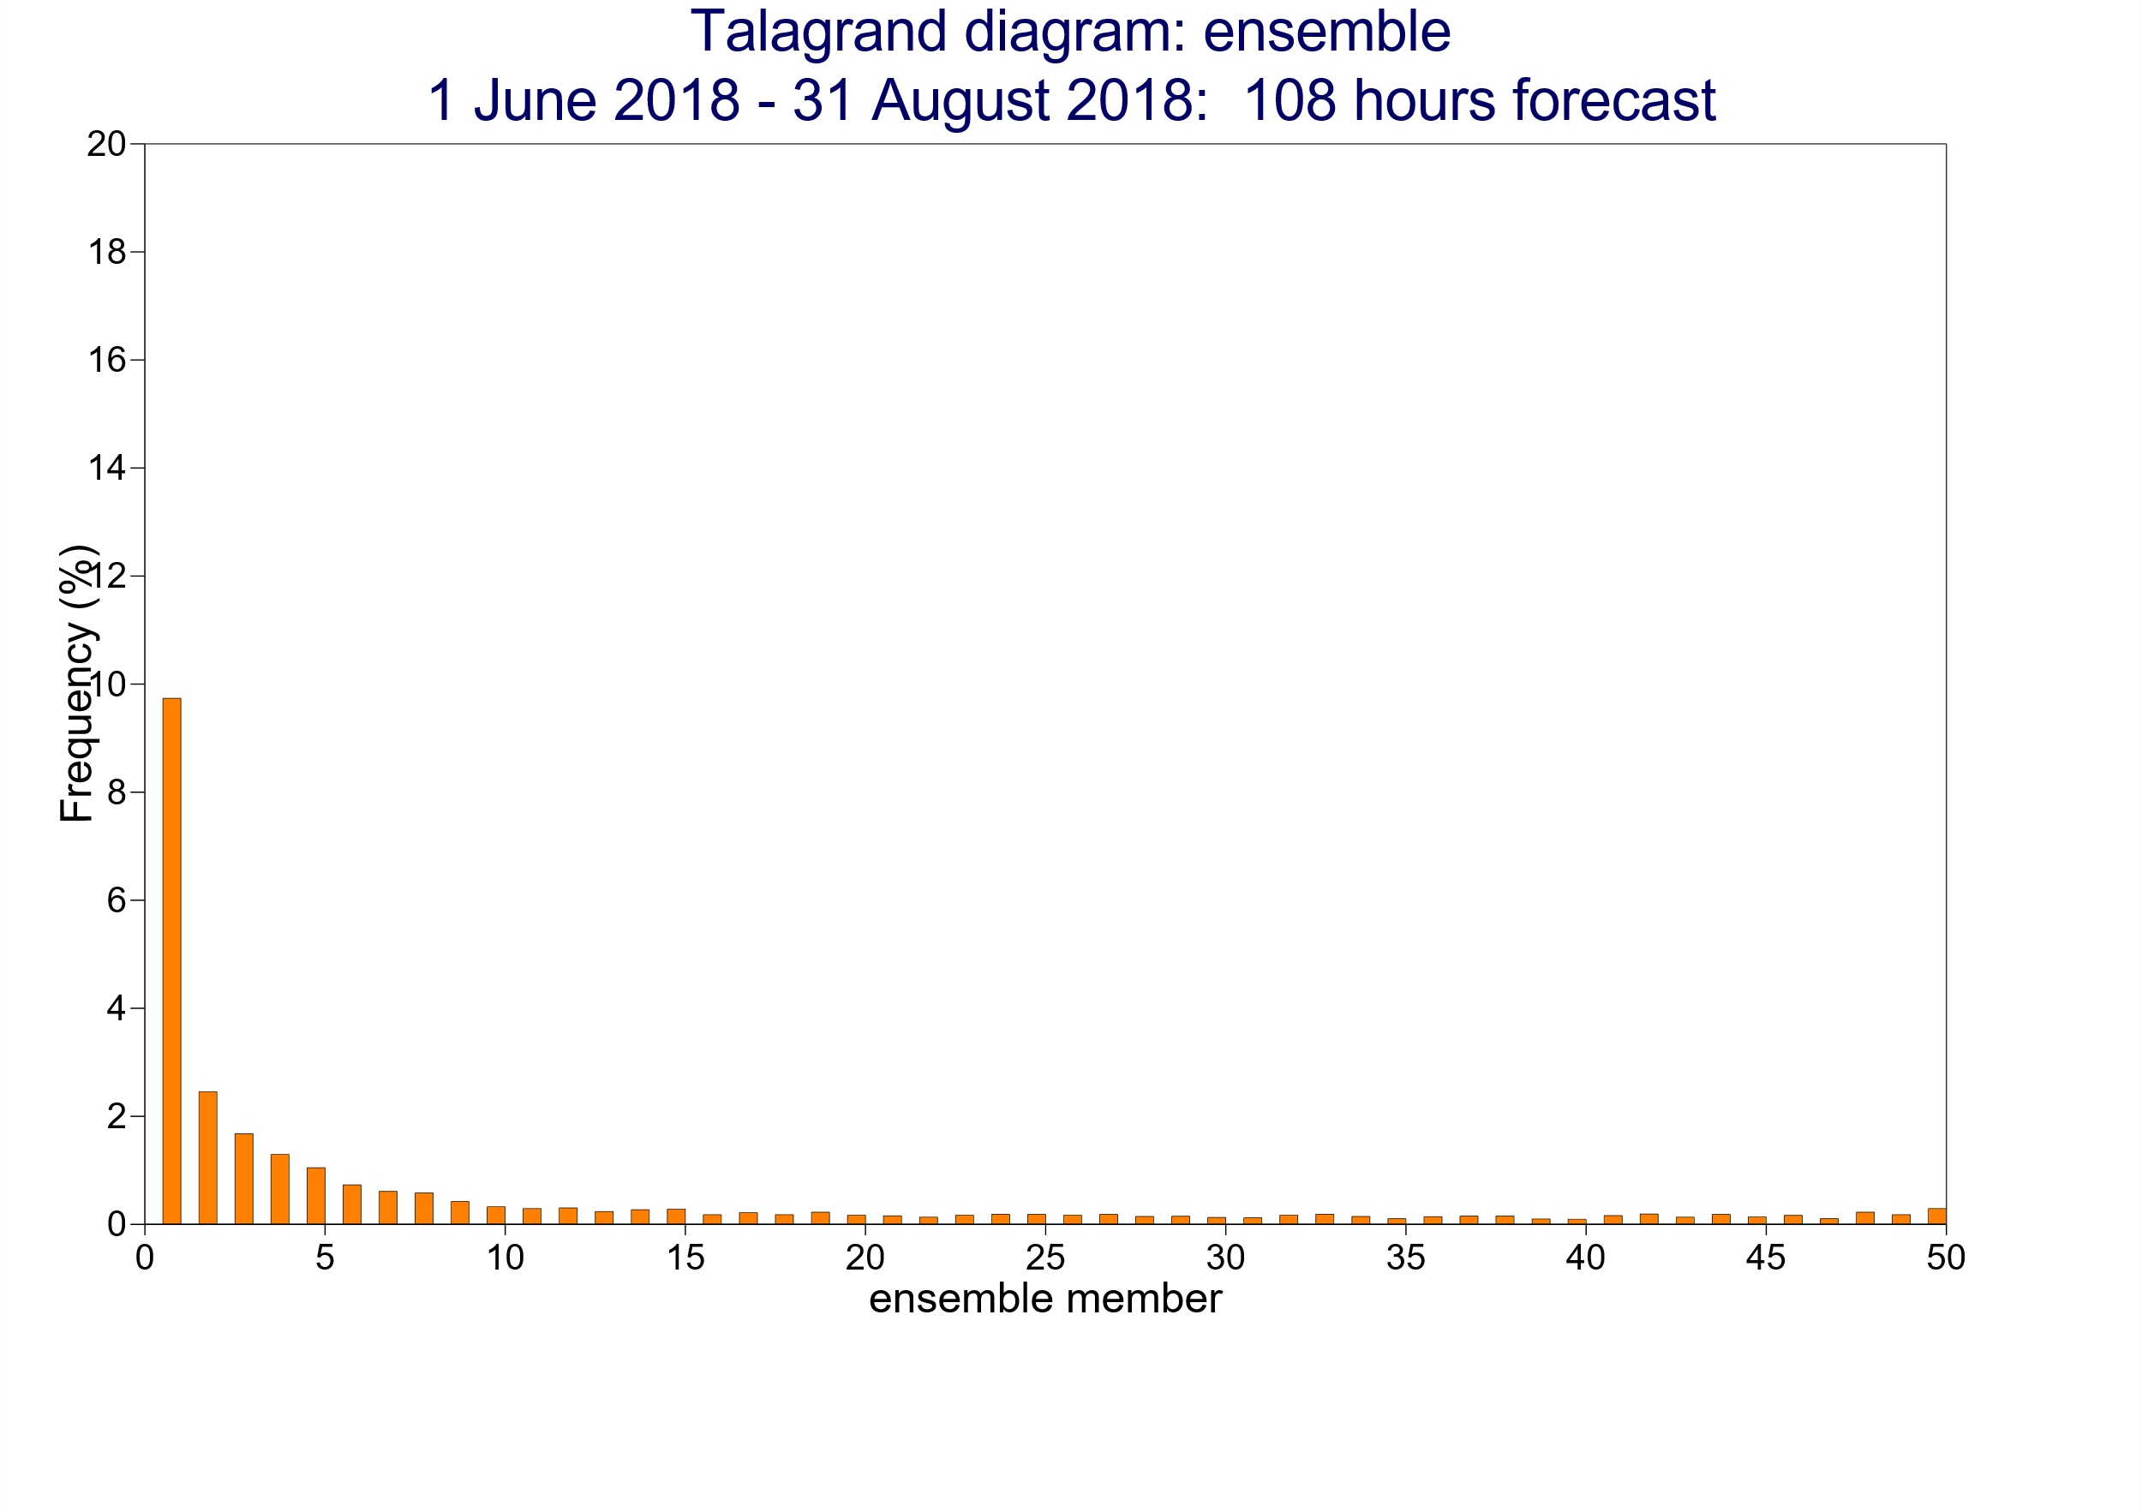
OMSZ Case Study
Rainfall observations
0
0.5
1.5
2.5
3.5
4.5
6.5
8.5
10.5
13.5
16.5
20.5
25.5
30.5
35.5
40.5
50.5
60.5
70.5
80.5
90.5
100
mm / 12h
[%]
2018/06/08 00 UTC (t+72,t+84), DAY 4
0
1
20
40
60
100
150
250
500
2018/06/10 00 UTC (t+24,t+36), DAY 2
ecPoint – Rainfall
Raw ENS
ecPoint – Rainfall
Raw ENS
2018/06/11 0 UTC to 2018/06/11 12 UTC
X
d
X
X
Prob. Non Exc.
10 mm/12h
100
50
ecPoint-R
0
b
Prob. [%]
ECMWF ENS
f
h
0
0
30
70
X
Rain [mm/12h]
Prob. Non Exc.
30 mm/12h
X
X
a
c
e
g
i
OMSZ Objective Verification
Location of rain gauges relative to ecPoint-Rainfall and Raw ECMWF ENS grid-points
j)
Number of days with overall good performance for ecPoint-Rainfall
(i.e. with no overall rainfall under- or overestimation)
Number of days with overall rainfall under- and
overestimation for ecPoint-Rainfall
Rain Gauge
No
Obs
Overall
under-/overest.
Overall good performance
No
Obs
No overall
under-/overest.
Overall Underest.
Overall Overest.
Grid-Box Centre
0
1
2
3
4
5
-5
-4
-3
-2
-1
1
2
3
4
5
6
7
8
9
10
l)
m)
(t+0,t+12), 85th Percentile & tp >= 15 mm/12h
Rain gauges height [m a.s.l.]
< 100
100 - 200
200 - 400
400 - 600
> 600
Talagrand diagrams
k)
20
18
ecPoint-Rainfall
(t+0,t+12)
ECMWF ENS
(t+0,t+12)
16
14
12
10
8
6
4
Perfectly reliable forecasts
Perfectly reliable forecasts
2
0
(t+0,t+12), 95th Percentile & tp >= 15 mm/12h
20
18
ecPoint-Rainfall
(t+96,t+108)
ECMWF ENS
(t+96,t+108)
16
14
12
Probability of Occurrence (%)
10
8
6
4
Perfectly reliable forecasts
Perfectly reliable forecasts
2
0
1
10
20
30
40
50
60
70
80
90
99
1
Ensemble Members
5
10
15
20
25
30
35
40
45
51
Ensemble Members

